Slide 1
Lecture 08: Dashboards
Chris Walshaw
Computing & Mathematical Sciences
University of Greenwich

Slide 2
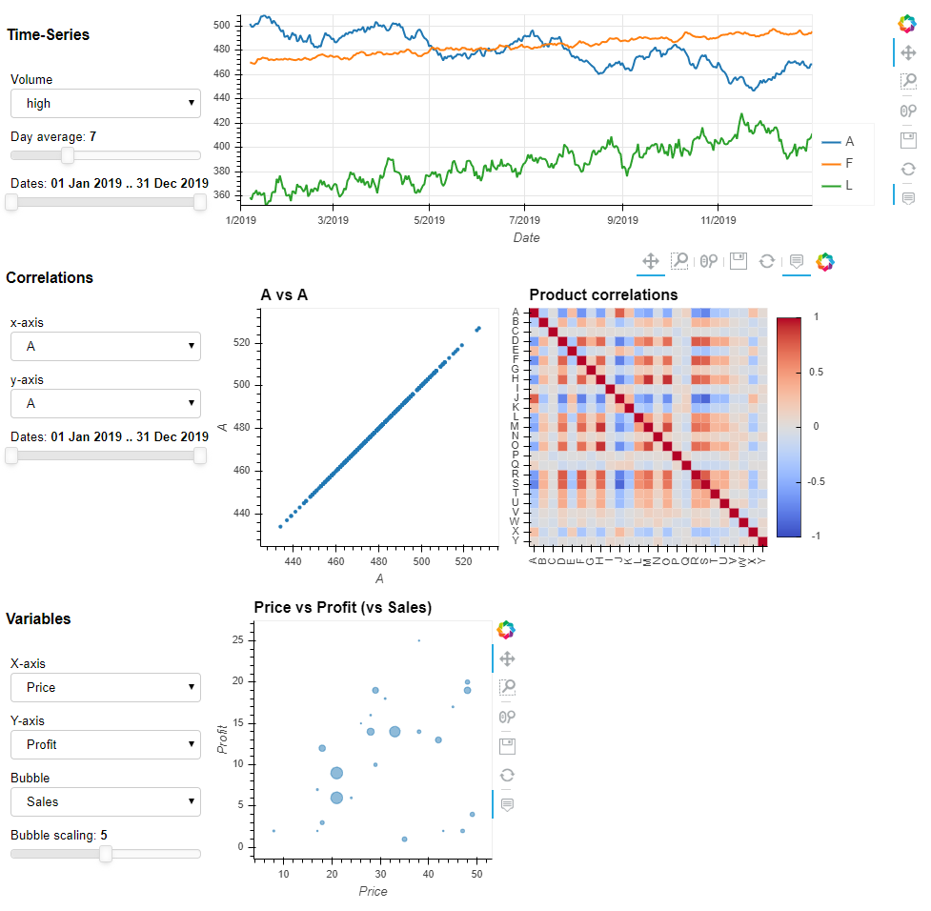
Motivation / Objectives
Last week we looked at interaction
allows the user to examine details of the data on their own
This week we will look at dashboards
these take the idea of interaction a stage further
we will use Colab (but see penultimate slide)

Slide 3
What is a dashboard
The term dashboard is modelled on what you find in a car
a set of dials, gauges, numerical readouts, warning lights, etc that give the driver a summary of what the car is doing and what state its systems are in
A data dashboard provides the same kind of information for a group of datasets
a set of charts, usually in a webpage, showing important features of the datasets
widgets (sliders, dropdown lists, etc) for exploring the data
Typically therefore a dashboard is characterised by
multiple charts on the same webpage
external widgets which react with those charts
Often a dashboard is linked to real-time data to give up-to-the-minute visualisations of evolving data
these are sometimes known as visual analytics
we shall not pursue this aspect but in principle it is not difficult, if you have a source of data, evolving in real time

Slide 4
Dashboard code components
Last week all of our interactive examples consisted of 2 basic components
import statements and code to read in the data
code which adapts the data as required and creates a chart (e.g. line plot)
All of the dashboard code in todays lecture consists of 3 basic components
import statements and code to read in the data
a function which adapts the data as required and creates a chart (e.g. line plot)
the controlling code which builds the webpage
So the big difference is that now we create the chart inside a function
the reason is that the chart will change according to what the widgets (e.g. date-range slider) are set to by the user
the controlling code passes widget values (e.g. a range of dates) into the function and the function constructs the chart accordingly

Slide 5
01TimeSeries all.ipynb
In today’s examples, the import and data reading code is similar to other lectures with a couple of differences
This week we are using panel to create the dashboards
import matplotlib.pyplot as plt
import pandas as pd
import hvplot.pandas
import panel as pn
pn.extension(comms='colab')
data = pd.read_csv('https://tinyurl.com/ChrisCoDV/Products/DailySales.csv’,
index_col=0)
data.index = pd.to_datetime(data.index)
print(data.head())

Slide 6
01TimeSeries all (cont’d)
The function to create the plot is similar to last week’s examples using hvplot
in this case, a line plot of all 25 products
The grid isn’t really necessary – it just makes the visualisation look nicer
def get_line_plot():
return data.hvplot.line(frame_width=600, frame_height=600, grid=True)

Slide 7
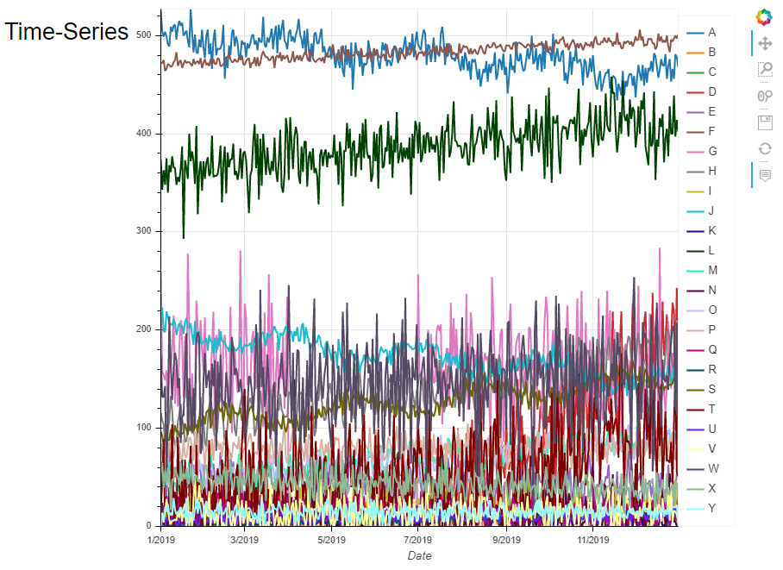
01TimeSeries all (cont’d)
The controlling code is the unfamiliar bit – but not complicated
The title of the page (in markdown)
A row of page elements – in this case just the title (in its own column) and the line plot
Must make the row servable so that it can run on a website
title_time = '## Time-Series'
row_time = pn.Row(
pn.Column(title_time),
get_line_plot()
)
row_time.servable()

Slide 8
02TimeSeries volume selector.ipynb
We can add a dropdown list to allow the user to select which group of data to look at (high volume, medium, etc)
Here’s the code to create the chart
Here volume is chosen by the user setting the dropdown and passed into the function as a parameter
def get_line_plot(volume):
if volume == 'high':
selected = ['A', 'F', 'L']
elif volume == 'medium':
selected = ['G', 'H', 'J', 'S', 'W']
elif volume == 'low':
selected = ['D', 'E', 'M', 'O', 'P', 'T', 'X']
else:
selected = ['B', 'C', 'I', 'K', 'N', 'Q', 'R', 'U', 'V', 'Y']
df = data[selected] # restrict to selected products
return df.hvplot.line(frame_width=600, grid=True)

Slide 9
02TimeSeries volume selector (cont’d)
The controlling code is only a little more complicated
create a dropdown widget using the values in volumes
include the dropdown in the left hand column
“watch” the dropdown and when it changes update the plot
title_time = '## Time-Series'
volumes = ['high', 'medium', 'low', 'very low']
volume = pn.widgets.Select(name='Volume', options=volumes, width=200)
row_time = pn.Row(
pn.Column(title_time, volume),
get_line_plot(volume.value)
)
def update_time(event):
row_time[1].object = get_line_plot(volume.value)
volume.param.watch(update_time, 'value')
row_time.servable()

Slide 10
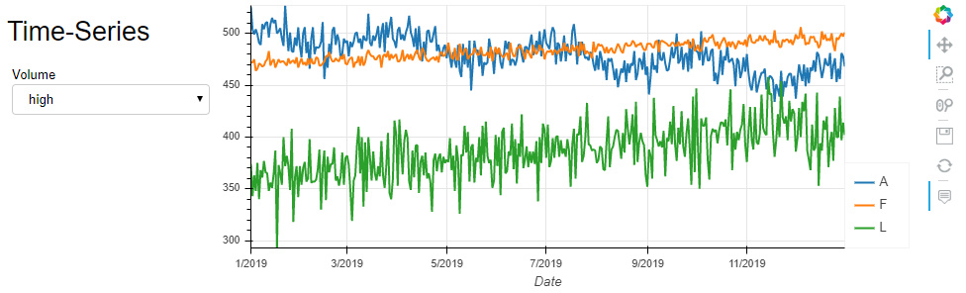
02TimeSeries volume selector (cont’d)
The resulting chart

Slide 11
03TimeSeries volume selector, average slider.ipynb
The time-series data is very noisy, especially for (very) low volumes
We could instead show a rolling average where the user controls the window size (i.e. the number days to average over) with a slider
when it’s set to 1, we just see the raw time series since you can’t average over just 1 value
def get_line_plot(volume, window_size):
if volume == 'high':
selected = ['A', 'F', 'L']
elif volume == 'medium':
selected = ['G', 'H', 'J', 'S', 'W']
elif volume == 'low':
selected = ['D', 'E', 'M', 'O', 'P', 'T', 'X']
else:
selected = ['B', 'C', 'I', 'K', 'N', 'Q', 'R', 'U', 'V', 'Y']
df = data[selected] # restrict to selected products
df = df.rolling(window=window_size).mean() # calculate rolling average
return df.hvplot.line(frame_width=600, grid=True)

Slide 12
03TimeSeries volume selector, average slider (cont’d)
The controlling code isn’t much more involved
time_title = '## Time-Series'
volumes = ['high', 'medium', 'low', 'very low']
volume = pn.widgets.Select(name='Volume', options=volumes, width=200)
day_avg = pn.widgets.IntSlider(name='Day average', value=7, start=1,
end=21, width=200)
time_row = pn.Row(
pn.Column(time_title, volume, day_avg),
get_line_plot(volume.value, day_avg.value)
)
def update_time_row(event):
time_row[1].object = get_line_plot(volume.value, day_avg.value)
volume.param.watch(update_time_row, 'value')
day_avg.param.watch(update_time_row, 'value')
time_row.servable()

Slide 13
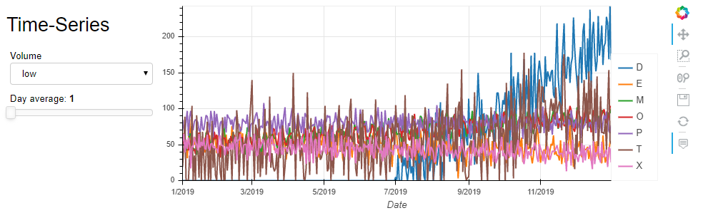
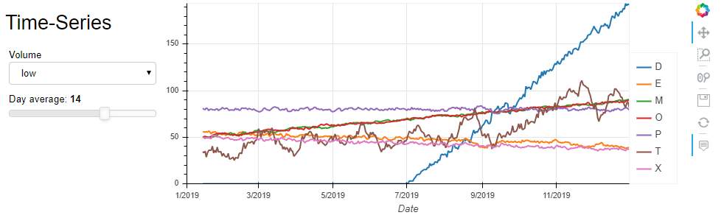
03TimeSeries volume selector, average slider (cont’d)
The resulting chart
low volume, day average 1
low volume, day average 14

Slide 14
04TimeSeries volume selector, average slider, date slider.ipynb
We can also allow the user to select a date range
same functionality as the box zoom, but more convenient
The controlling code is similar to before except we also create a date range slider, add it to the page and “watch” it
def get_line_plot(volume, window_size, date_range):
if volume == 'high':
selected = ['A', 'F', 'L']
elif volume == 'medium':
selected = ['G', 'H', 'J', 'S', 'W']
elif volume == 'low':
selected = ['D', 'E', 'M', 'O', 'P', 'T', 'X']
else:
selected = ['B', 'C', 'I', 'K', 'N', 'Q', 'R', 'U', 'V', 'Y']
df = data[selected] # restrict to selected products
df = df.rolling(window=window_size).mean() # calculate rolling average
df = df.loc[pd.to_datetime(date_range[0]) :
pd.to_datetime(date_range[1])] # restrict to date range
return df.hvplot.line(frame_width=600, grid=True)

Slide 15
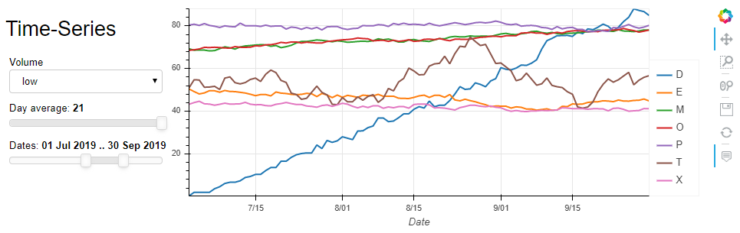
04TimeSeries volume selector, average slider, date slider (cont’d)
The resulting chart

Slide 16
05Correlation.ipynb
Of course we don’t just have to show line plots – the next couple of examples allow the user to check correlations interactively
The user chooses two products, via two dropdowns, and the chart function now returns a scatter plot showing their correlation
def get_correlation_plots(product_x, product_y):
df = data
return df.hvplot.scatter(frame_height=300, frame_width=300,
x=product_x, y=product_y,
title=product_x + ' vs ' + product_y,
size=10, padding=0.1)

Slide 17
05Correlation (cont’d)
Here’s the controlling code
correlation_title = '## Correlations'
product_x = pn.widgets.Select(name='x-axis', options=list(data.columns),
width=200)
product_y = pn.widgets.Select(name='y-axis', options=list(data.columns),
width=200)
correlation_row = pn.Row(
pn.Column(correlation_title, product_x, product_y),
get_correlation_plots(product_x.value, product_y.value)
)
def update_correlation_row(event):
correlation_row[1].object = get_correlation_plots(product_x.value,
product_y.value)
product_x.param.watch(update_correlation_row, 'value')
product_y.param.watch(update_correlation_row, 'value')
correlation_row.servable()

Slide 18
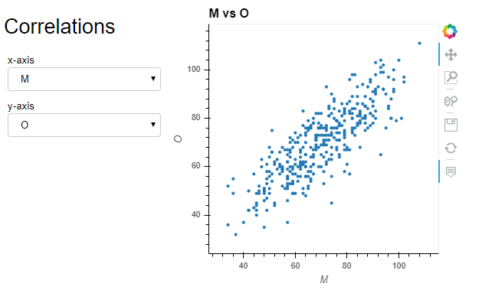
05Correlation (cont’d)
The resulting chart

Slide 19
06Correlation heatmap.ipynb
Of course we should let the user know which products are correlated
so let’s add a heatmap
If we want the function to return two plots side by side, we can just “add” them together
Note that the controlling code is completely unchanged from the previous example as the heatmap is not controlled by any widgets
def get_correlation_plots(product_x, product_y):
df = data
return df.hvplot.scatter(frame_height=300, frame_width=300,
x=product_x, y=product_y,
title=product_x + ' vs ' + product_y,
size=10, padding=0.1) +\
df.corr().hvplot.heatmap(frame_height=300, frame_width=300,
title='Product correlations',
rot=90, cmap='coolwarm'
).opts(invert_yaxis=True, clim=(-1, 1))
the + adds the two plots together
the \ lets python know that the thing being added is on the next line of code

Slide 20
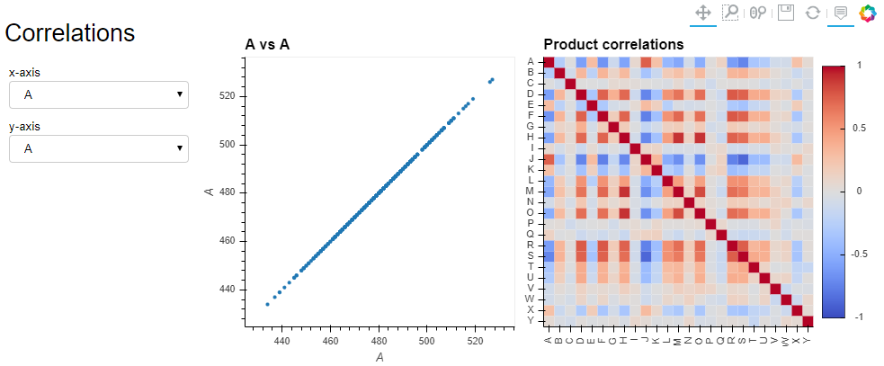
06Correlation heatmap (cont’d)
The resulting chart

Slide 21
07Correlation heatmap, date slider.ipynb
Another possibility is to restrict the date range for the correlation and heatmap
because the time series might be correlated with each other only during certain periods of the year
The controlling code is similar to before except we also create a date range slider, add it to the page and “watch” it
def get_correlation_plots(product_x, product_y, date_range):
df = data.loc[pd.to_datetime(date_range[0]) :
pd.to_datetime(date_range[1])] # restrict to date range
return df.hvplot.scatter(frame_height=300, frame_width=300,
x=product_x, y=product_y,
title=product_x + ' vs ' + product_y,
size=10, padding=0.1) +\
df.corr().hvplot.heatmap(frame_height=300, frame_width=300,
title='Product correlations',
rot=90, cmap='coolwarm'
).opts(invert_yaxis=True, clim=(-1, 1))

Slide 22
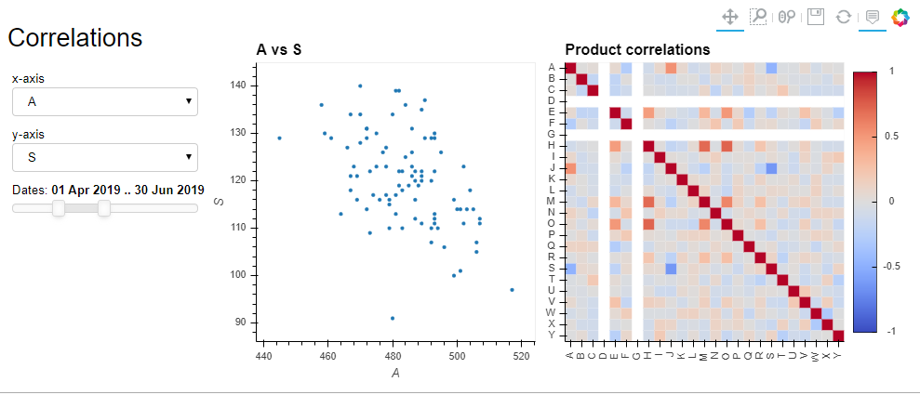
07Correlation heatmap, date slider (cont’d)
The resulting chart
notice the two white rows / columns – because products D & G had zero sales during this period

Slide 23
08Variables.ipynb
The next examples replicate the bubble plots we created for comparing 3 summary variables (price / profit / etc)
However, using 3 dropdowns means the user can choose which variables
We need to read in / compute the summary_data as before and then calculate appropriate bubble sizes
In this version the bubble sizes are normalised (so they are all between 0 and 1) and then multiplied by 200
def get_summary_plots(variable_x, variable_y, variable_z):
summary_data['BubbleSize'] = summary_data[variable_z]
/ summary_data[variable_z].max() * 200
return summary_data.hvplot.scatter(frame_height=300, frame_width=300,
title=variable_x + ' vs ' + variable_y + ' (vs ' + variable_z + ')',
alpha=0.5, hover_cols='all', padding=0.1,
x=variable_x, y=variable_y, size='BubbleSize')

Slide 24
08Variables (cont’d)
Here’s a snippet of the controlling code – the bit which creates 3 dropdowns
Notice that this time we set the initial value (shown in bold) for each dropdown as the first, second and third elements in the list of variables
variable_x = pn.widgets.Select(name='X-axis', options=variables,
value=variables[0], width=200)
variable_y = pn.widgets.Select(name='Y-axis', options=variables,
value=variables[1], width=200)
variable_z = pn.widgets.Select(name='Bubble', options=variables,
value=variables[2], width=200)

Slide 25
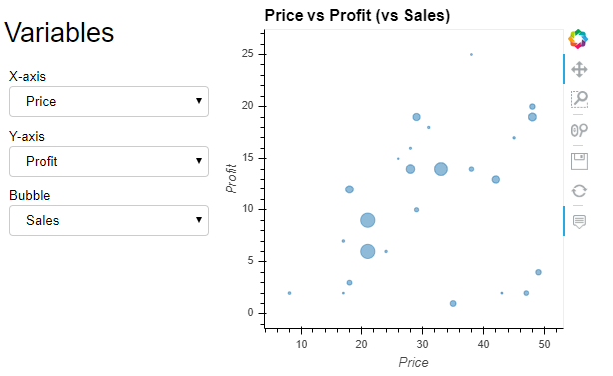
08Variables (cont’d)
The resulting chart

Slide 26
09Variables bubble scaling.ipynb
The bubble scaling is a bit of a guess and the user might want something different
easy – just add a slider so the user can control it
The controlling code is similar to the previous example except we also create a bubble size slider, add it to the page and “watch” it
def get_summary_plots(variable_x, variable_y, variable_z, bubble_scaling):
summary_data['BubbleSize'] = summary_data[variable_z]
/ summary_data[variable_z].max() * math.exp(bubble_scaling)
return summary_data.hvplot.scatter(frame_height=300, frame_width=300,
title=variable_x + ' vs ' + variable_y + ' (vs ' + variable_z + ')',
alpha=0.5, hover_cols='all', padding=0.1,
x=variable_x, y=variable_y, size='BubbleSize')

Slide 27
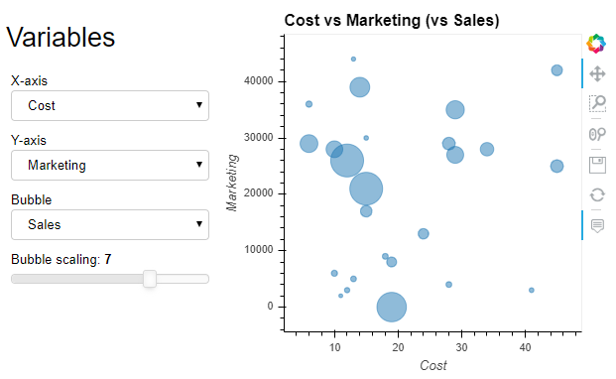
09Variables bubble scaling (cont’d)
The resulting chart

Slide 28
10Dashboard.ipynb
The final example combines all three charts with their widgets into a single page
Essentially just combine all the code from examples 04, 07 & 09 into a single notebook
just need one import and data read in section at the top (rather than 3 separate sections)
but then the code for each function and controller is unchanged
If you want to see this as a single webpage without the code showing, open a command prompt in the folder and type
panel serve --show 10Dashboard_standalone.ipynb
works on my laptop (where I can install packages but not on University machines)

Slide 29
10Dashboard (cont’d)
the finished dashboard

Slide 30
Notebook issues
Colab versions require a !pip install … at the start of each notebook (slow to start up)
also requires pn.extension(comms='colab') in the first code cell
Jupyter versions will only work if you have write access to your Python installation (e.g. on your laptop)
also requires pn.extension() in the first code cell
they will not work in the University labs
There are compatibility problems between Anaconda/Jupyter and hvplot (interactive plots)
Anaconda restricts the version of Jupyter and runs a version which is incompatible with hvplot
so interactive examples from lectures 7 and 8 will not work in Anaconda

Slide 31
Lecture summary
No particular data conclusions this week
Looked at dashboards / visual analytics
A dashboard is a tool generally aimed at the data owner/producer rather than the data scientist
however, if well designed, it does allow both user-types to explore the data very easily
Caveat: the dashboard code may take a little work to configure correctly

